Slide 1
LUPMIS2
What Changed Since March 2026
Workshop Summary · March – June 2026
LUPMIS2 Development Team · 25 June 2026

Slide 2
OVERVIEW
Ten capability headlines
Each gets its own slide later. These are the talking points to lead with.
Field-grade offline mode every map layer cached locally; SW v4→v10
GIS export GeoJSON / Shapefile / KML from analysis popups
GPS trail recording live capture in the field, reusable engine
3 new map layers + 4 new basemaps + a “None” option
SSO sign-in + district scoping no more hardcoded district 1
3 advanced drawing tools Divide / Split / Merge + snap + vertex
Iframe embed shipped to production pwa.lupmis4luspa.org/embed for permitting
Mobile-first responsive toolbar fits on a phone, only visible in Draw mode
Drag-and-drop dataset import Shapefile / GeoJSON / KML, staged upload
4 published design / concept notes for the team and partner apps

Slide 3
CAPABILITY · 1
Offline capability & field reliability
Surveyors spend most of the day off-network. The PWA had to become genuinely usable with no signal at all.
Persistent per-provider tile cache OSM · OpenTopoMap · Satellite · Google · Carto Light/Dark · OSM Cycle — each cached independently with a download-area control.
Local SQLocal cache for every server layer parcels, zones, footprints, OSM roads, contours, UPN grid. Renders from cache on a fresh airplane-mode start.
Service Worker progression v4 → v10 HTML now network-first; hashed JS/CSS/WASM stay cache-first; per-provider tile-cache wipe via MessageChannel.
Cross-browser Safari layout fix bottom-dock labels no longer clipped — .app-container switched from 100dvh to 100svh.

Slide 4
CAPABILITY · 2
Drawing & editing tools
Three new advanced editing tools the field team had requested — all working on any visible vector layer.
Polygon Divide parameter-driven equal-area division; user picks which piece keeps the UPN.
Polygon Split (lines + polygons) ol-ext Split for lines, custom interaction for polygons; UPN-chooser popup on completion.
Polygon Merge pick two adjacent polygons, click shared edges — single feature with UPN-chooser.
Snap guides + magnet toggle alignment guides while drawing/modifying; user preference persisted in localStorage.
Mobile responsive toolbar (<576 px) wraps to two rows; appears only in Draw mode; row 2 right-aligned to clear Select option bar.

Slide 5
CAPABILITY · 3
New map layers & basemaps
BASEMAPS
OVERLAYS
Topographic OpenTopoMap — now default
Contours Hillshade ETL'd from OpenTopography
Carto Light · Carto Dark high-contrast city tiles
OSM Roads district sub-set from OSM
OSM Cycle Thunderforest
Building Footprints per-district cache
"None" blank background — for full-coverage overlays
UPN Grid (NEW) sub-division grid; label at 1:25k+
Branded thumbnail picker replaces inline LayerSwitcher entries
Single-click → upn_prefix minimal popup, no clutter

Slide 6
CAPABILITY · 4
GPS trail recording (field use)
Specifically requested by the field team. Built as a reusable module so other LUSPA apps can adopt it.
Expandable My Location control tap to reveal Locate Me + Record Trail sub-buttons.
Live position + accuracy halo on the map with a growing trail polyline drawn as you walk.
Live GPS readout in the navbar lon / lat, accuracy in metres, satellite slot — colour-coded by fix quality.
Local-first storage + store-and-forward gps_trails + gps_trail_points; per-feature client_uuid for server-side de-dup.
Reusable engine src/geotracker/ is framework-agnostic — one adapter file and it runs in another app.

Slide 7
CAPABILITY · 5
Authentication & identity
End-to-end SSO with the LUSPA central portal, plus the safety nets around it. Local dev still works.
SSO via the LUSPA portal cookie shared across subdomains; PHP validates server-side and injects window.LUPMIS_SESSION.
Per-user district scoping every API call automatically uses the user's district_id — the hard-coded 1 is gone.
Production access guard direct visits to index.php without a session redirect to the SSO portal.
"No district assigned" overlay authenticated users without a district see a clear blocker — no silent fallback.
Account menu in the navbar user info, sign-out, dev-mode indicator.

Slide 8
CAPABILITY · 6
Dataset import (drag-and-drop)
End-to-end pipeline from a file on the user's desktop to a reviewed row in the LUSPA database. Client side complete; server endpoints awaited.
Drop a .shp / .geojson / .kml on the map the layer appears, mapping modal opens automatically.
Auto-detected target + auto-mapped fields Parcels / Zones / OSM Roads / Building Footprints / Other (view only).
"Save mapping" or "Save + Upload now" "Other (view only)" is the safe default — visible but not uploadable.
LayerSwitcher badge reflects state "Upload 247" → spinner → "✓ submitted" → "✓ live" (after supervisor review).
Aligned with the staged-upload model payloads land in lu_parcels_upload_tmp; user_id_upload sent from SSO session.

Slide 9
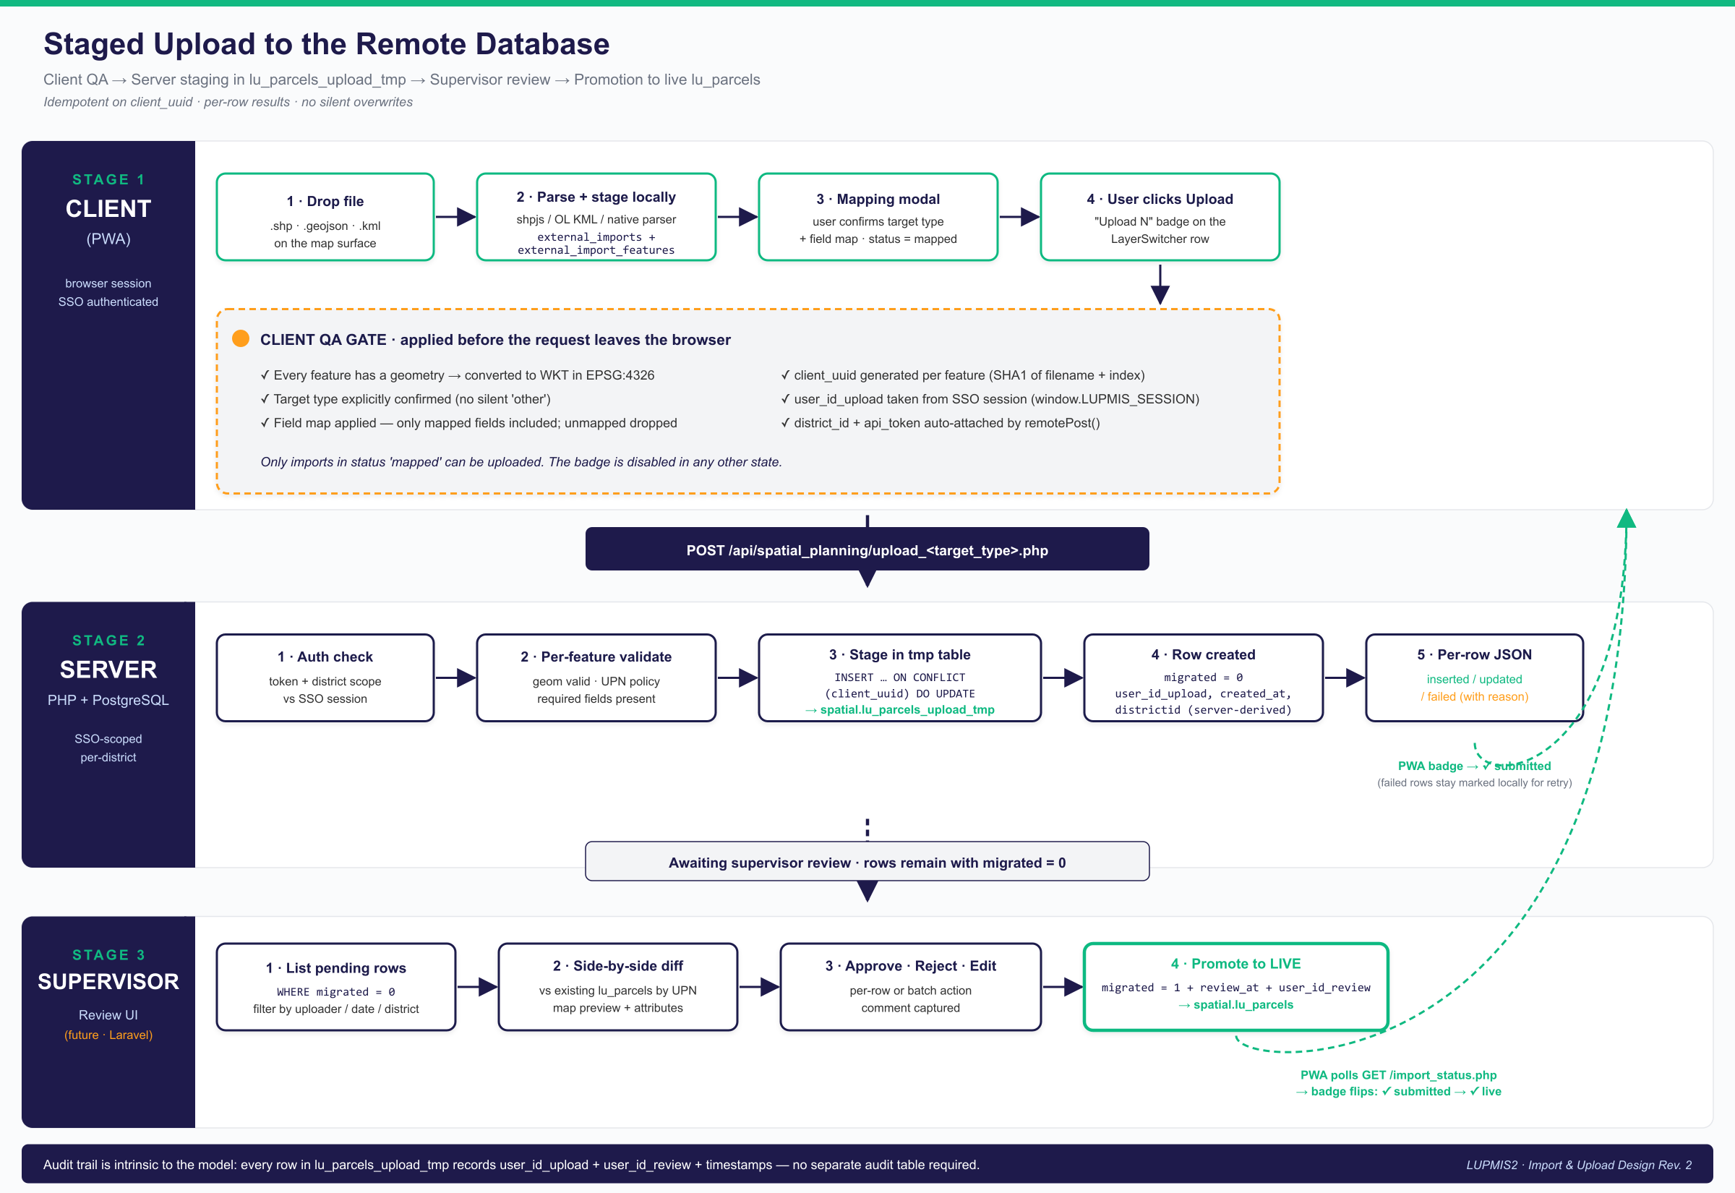
DEEP DIVE
Staged upload — end to end
Client QA before sending → server-side staging in lu_parcels_upload_tmp → supervisor review → promotion to live lu_parcels.
No silent overwrites. Every server row is idempotent on client_uuid; supervisors approve before promotion to live; audit trail is intrinsic to the temp table (user_id_upload + user_id_review + timestamps).

Slide 10
CAPABILITY · 7
Data export
The Area / Circle Analysis popup now has two export buttons instead of one.
GeoJSON
Shapefile
KML
default · lossless
.zip via shp-write
for Google Earth
Plain text, broadly compatible. Field renames flow straight through.
Per-geometry-type split. DBF-safe 10-char field names with collision suffixing.
First non-empty renamed field becomes the placemark <name>.
Field-rename modal before export. Same UI pattern as the import flow but in reverse. Drop a field by clearing its name.
Provenance preserved. Every exported feature carries a _source attribute (the layer of origin).

Slide 11
CAPABILITY · 8
Reusability & integration
Two LUPMIS2 capabilities are now consumable by other LUSPA apps. The reuse approach is documented in three layers.
Iframe embed at /embed (in production) URL params + postMessage protocol; selected-parcel highlight; in-iframe sign-in card.
Reusable Mapping Concept — 3 layers §3.1 map-core library · §3.2 iframe (already shipped) · §3.3 web component.
Reusable GeoTracker module same pattern as map-core — framework-agnostic engine + adapter pattern.
Permit Map Integration spec full contract handed to the Permitting team with their show.blade.php changes.

Slide 12
CAPABILITY · 9
Architecture & resilience
Quieter but important changes that keep the app robust as the data model and partner apps evolve.
lu_parcels schema realignment local table mirrors the server's 27-column structure; Local Data viewer shows real fields.
Bulk-insert transaction wrapper 25,000-row parcel refresh runs in a single BEGIN/COMMIT — fast and atomic.
LayerSwitcher ordering fix groups resolved by reference, not by "length − 1" — deterministic after future additions.
API endpoint diagnostics three server-side bugs caught and reported back early (contours, UPN grid payload, district_id parsing).
Defence-in-depth security frame-ancestors CSP + X-Frame-Options strip at both .htaccess and PHP layers.

Slide 13
CAPABILITY · 10
Documentation
Four new design / concept documents and three editions of the running status report.
LUPMIS2_Reusable_Mapping_Concept.docx architecture concept for cross-app reuse — basis of the iframe embed.
LUPMIS2_OSM_3D_Buildings_Concept.docx feasibility analysis — deferred because true 3D conflicts with offline-first.
LUPMIS2_Permit_Map_Integration.docx integration spec delivered to the Permitting team.
LUPMIS2_Import_Upload_Design.docx (Rev 1 → 2) updated after the database team chose the staged-upload model.
LUPMIS2_Development_Status_Report-v3.docx running record — 15 sections, ~490 paragraphs.

Slide 14
AHEAD
What's next
Mostly waiting on partner teams; ready to ship as soon as endpoints land.
Database team endpoints upload_<target>.php · import_status.php (status polling) · save_gps_trail.php.
UNIQUE(upn) policy on lu_parcels_upload_tmp Option A (reject) vs Option B (upsert-on-pending) — decision pending.
Supervisor review UI for the staged-upload queue — Laravel side, not the PWA.
map-core library extraction Phase 2 of the reuse plan, triggered when a second consumer needs it.
Permit-app iframe final fix X-Frame-Options injected by the container proxy — awaiting devops access.

Slide 15
BY THE NUMBERS
Sizing the four-month sprint
~4 mo
6
7
March – June 2026
Service Worker versions (v4 → v10)
New local SQLocal tables
8
4
1
New front-end modules
Design / concept documents
Iframe embed in production

Slide 16
In one sentence
LUPMIS2 went from a single-user offline-leaning map app to a multi-user, single-sign-on, district-scoped, offline-first field tool that also publishes a reusable map embed for sibling LUSPA applications and supports bi-directional GIS data exchange with the central database.
All of this is in production on pwa.lupmis4luspa.org — except where explicitly noted as awaiting a database endpoint.
Thank you

